Slide 1
To Play and Cooperate in Imperfect Information Game with Reinforcement Learning
Ng Argens

Slide 2
Project Scope
To use RL in the bidding phase of Bridge
Cooperative
Imperfect information
Par Value
Bridge
Players form pairs of two
Players hold 13 cards, known only to oneself
Bids to show information (transparent to partner and opponent)
To land a contract with greatest EV to the pair

Slide 3
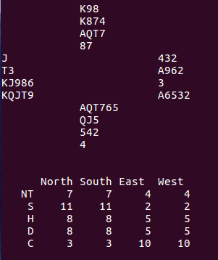
Example
1D: 3+ D, 11-21 HCP

Slide 4
Example
1D: 3+ D, 11-21 HCP
1S: 4+S, 6+HCP

Slide 5
Example
1D: 3+ D, 11-21 HCP
2N: 5+C, 5+D
1S: 4+S, 6+HCP

Slide 6
Example
4S + 1: 650

Slide 7
Example
4S + 1: 650
6C X - 2: -500

Slide 8
Original Plan
Fixed bidding system
Human inputs
Obtain meanings by longest matching string
Bid to convey information

Slide 9
Example
1D: 3+ D, 11-21 HCP

Slide 10
Difficulties
Human bidding bases are too complicated to generalize into fixed size input
Example
2D: Weak (6+ Spades OR 6+ Hearts) OR Strong (Any 4441 OR 5440)
3N: AKQxxxx + in Clubs OR Diamonds
2C: 22+ HCP OR 8.5 Winning Tricks

Slide 11
Revised Plan
Let agents bid freely and learn from the final contract
Collect the average hand/shape of each chosen bid

Slide 12
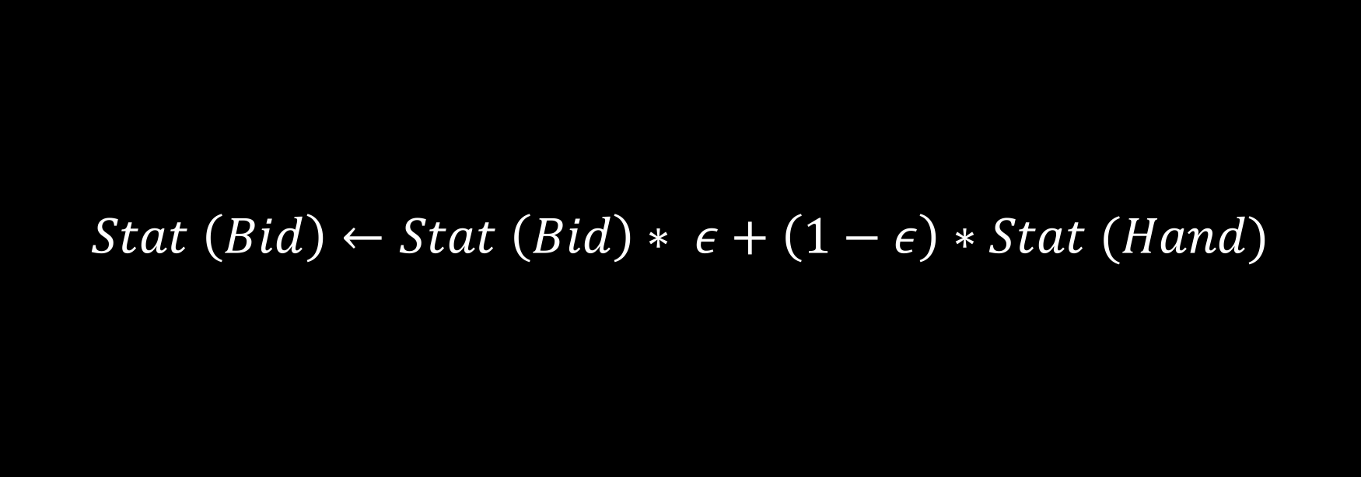
Revised Plan
$$Stat \left(Bid\right)←Stat \left(Bid\right)∗ ε+\left(1−ε\right)∗Stat (Hand)$$

Slide 13
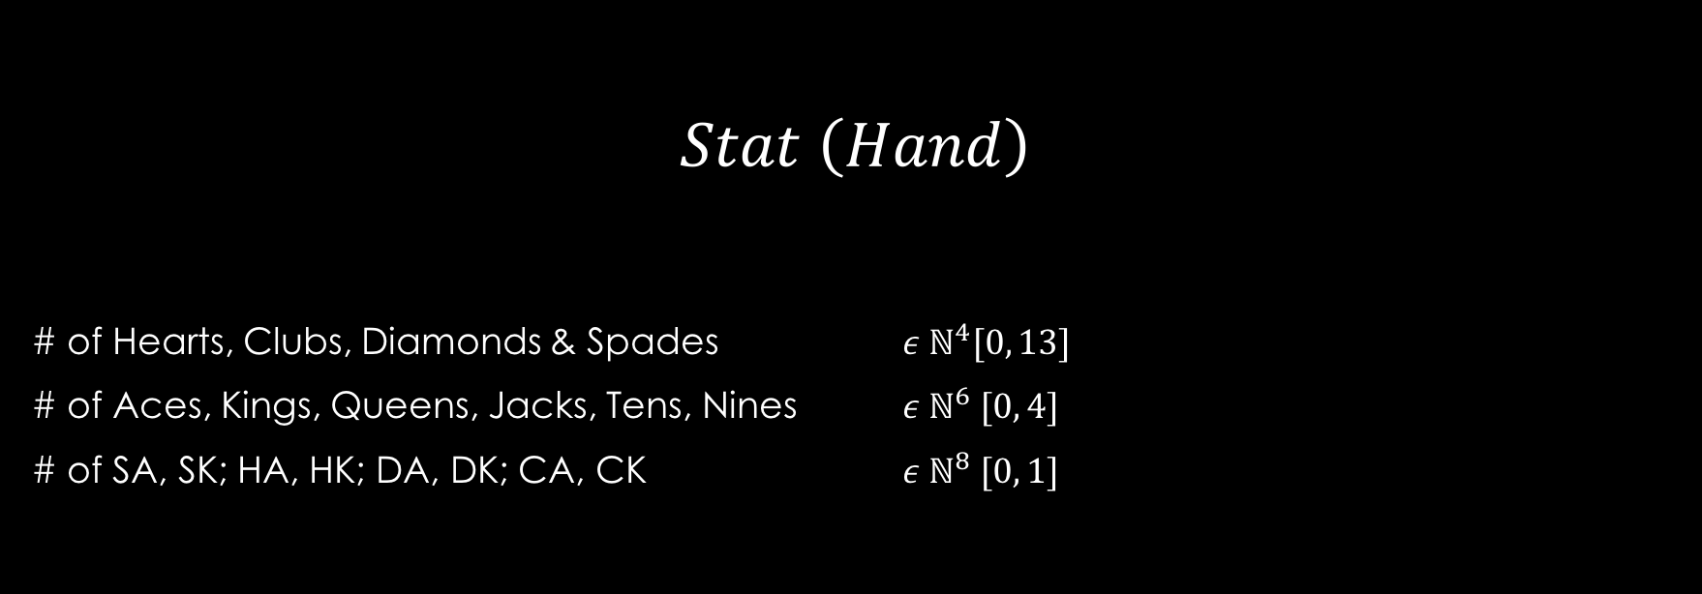
Revised Plan
$$Stat \left(Hand\right)$$
# of Hearts, Clubs, Diamonds & Spades $ε ℕ^{4}[0, 13]$
# of Aces, Kings, Queens, Jacks, Tens, Nines $ε ℕ^{6} [0, 4]$
# of SA, SK; HA, HK; DA, DK; CA, CK $ε ℕ^{8} [0, 1]$

Slide 14
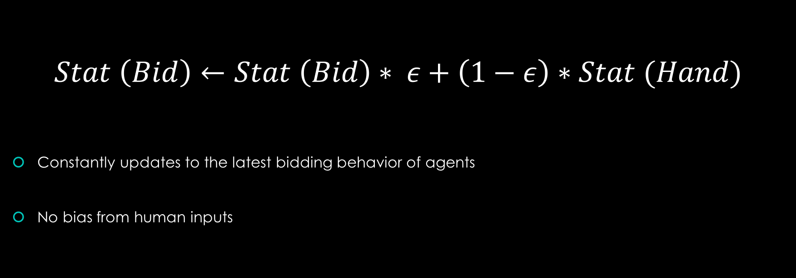
Revised Plan
$$Stat \left(Bid\right)←Stat \left(Bid\right)∗ ε+\left(1−ε\right)∗Stat (Hand)$$
Constantly updates to the latest bidding behavior of agents
No bias from human inputs

Slide 15
Revised Plan
Let agents bid freely and learn from the final contract
Collect the average hand/shape of each chosen bid

Slide 16
Regret Minimization
Is the basic algorithm in Libratus and Claudico
Libratus
Improved version of Claudico
Beats 4 profession human Texas Hold’em players
Win-rate of 14.7 big blinds per 100 games
Works well in incomplete information scenarios

Slide 17
Regret
Emotion felt when a decision leads to unfavorable results
Utility difference between more optimal actions and the chosen action (at certain state)

Slide 18
Regret
Assume we are playing a game of rock-paper-scissors
st. Rock beats Scissors; Scissors beats Paper; And Paper beats Rock
Hence, the utility table is:
 | Rock | Paper | Scissors
Rock | 0 | -1 | 1
Paper | 1 | 0 | -1
Scissors | -1 | 1 | 0

Slide 19
Regret
In one game, we played Rock
Opponent played Paper
Hence,
Regret (Scissors) = 1- (-1) = 2
Regret (Paper) = 0 - (-1) = 1
 | Rock | Paper | Scissors
Rock | 0 | -1 | 1
Paper | 1 | 0 | -1
Scissors | -1 | 1 | 0

Slide 20
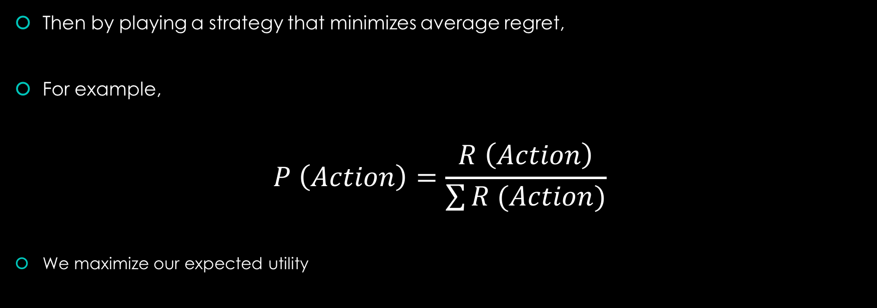
Regret
Then by playing a strategy that minimizes average regret,
For example,
$$P \left(Action\right)=\frac{R \left(Action\right)}{\sum{R (Action)}}$$
We maximize our expected utility
Reference: https://zhuanlan.zhihu.com/p/30438383

Slide 21
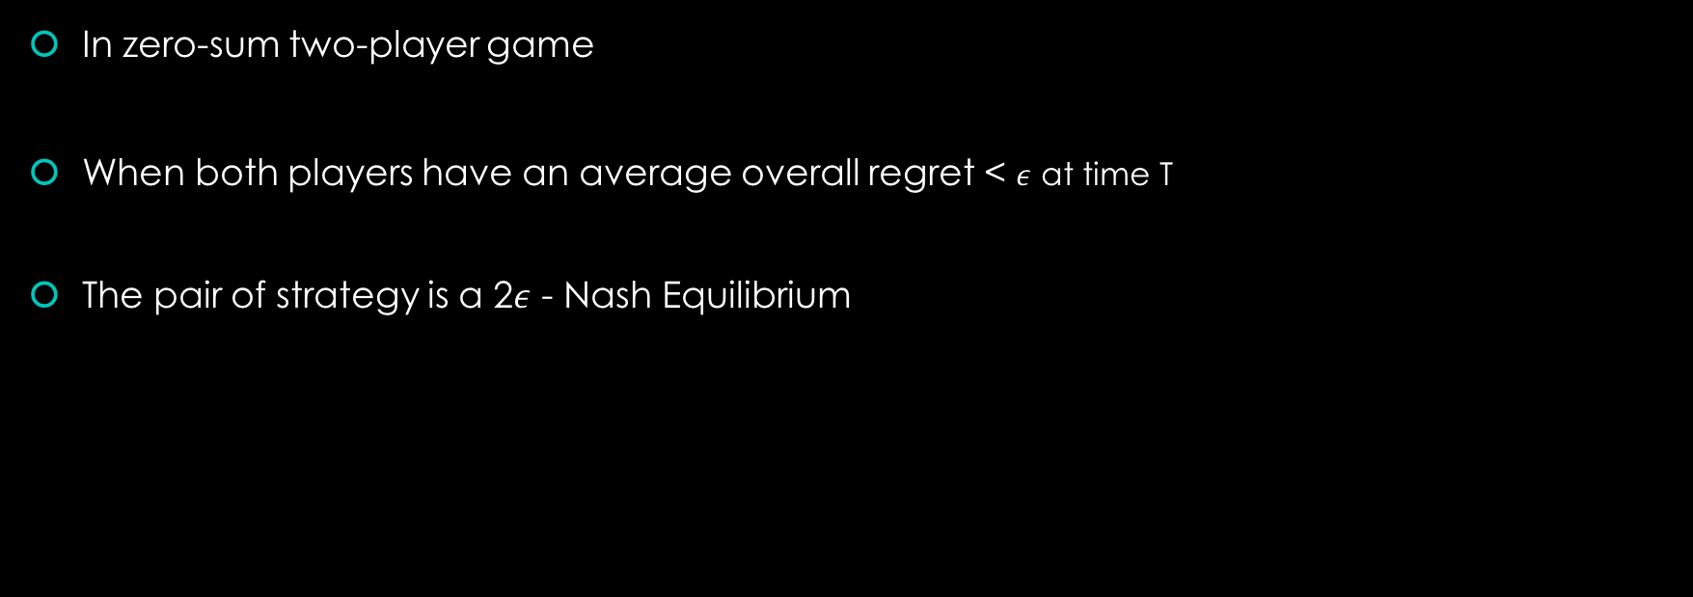
Regret
In zero-sum two-player game
When both players have an average overall regret < $ε$ at time T
The pair of strategy is a 2$ε$ - Nash Equilibrium
Reference: Regret Minimization in Game with Incomplete Information
(Zinkevichh, M., Johanson, M., Bowling, .,PiccioneC., 2007)

Slide 22

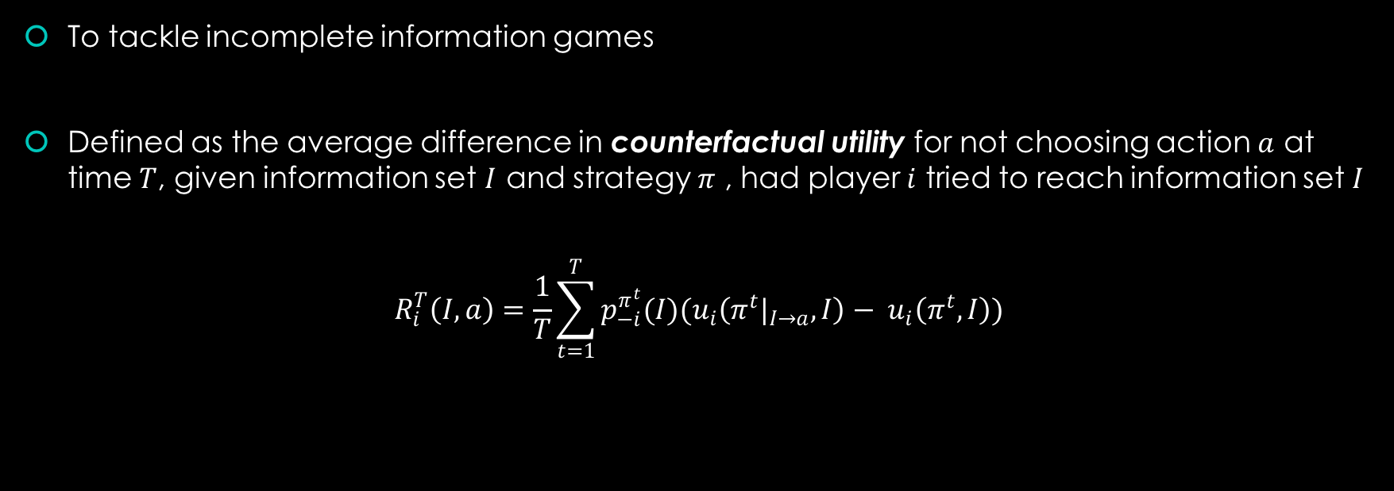
Counterfactual Regret - $R_{i}^{T}\left(I, a\right)$
To tackle incomplete information games
Defined as the average difference in counterfactual utility for not choosing action $a$ at time $T$, given information set $I$ and strategy $π$ , had player $i$ tried to reach information set $I$
$$R_{i}^{T}\left(I, a\right)=\frac{1}{T}\sum_{t=1}^{T}{p_{−i}^{π^{t}}(I)(u_{i}\left({π^{t}|}_{I→a}, I\right)− u_{i}\left(π^{t},I\right))}$$
Reference: Regret Minimization in Game with Incomplete Information
(Zinkevichh, M., Johanson, M., Bowling, .,PiccioneC., 2007)

Slide 23

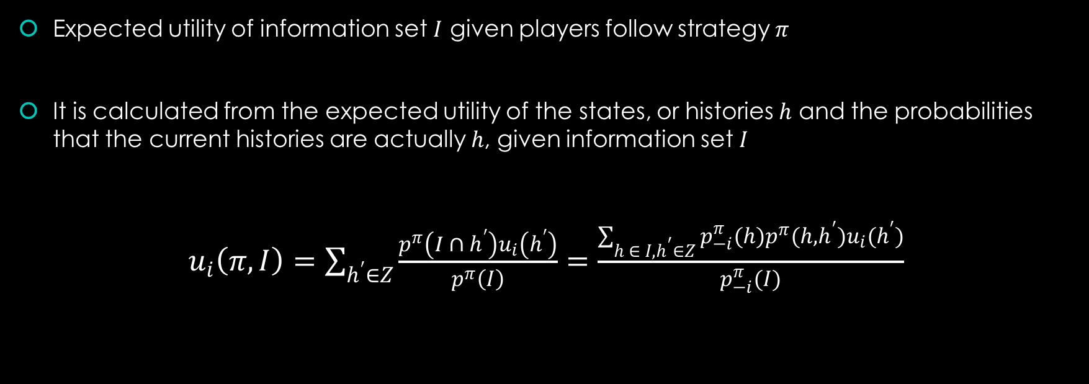
Counterfactual Utility - $u_{i}\left(π,I\right)$
Expected utility of information set $I$ given players follow strategy $π$
It is calculated from the expected utility of the states, or histories $h$ and the probabilities that the current histories are actually $h$, given information set $I$
$u_{i}\left(π,I\right)=\sum_{h^{′}∈Z}{\frac{p^{π}\left({I ∩ h}^{′}\right)u_{i}\left(h^{′}\right)}{p^{π}\left(I\right)}}$ $=\frac{\sum_{h ∈ I, h^{′}∈Z}{p_{−i}^{π}(h)p^{π}(h,h^{′})u_{i}(h^{′})}}{p_{−i}^{π}(I)}$
Reference: Zinkevich, M., Johanson. M., Bowling, M., Piccione, C. (2007). Regret Minimization in Games with Incomplete Information. Proceedings of the 20th Advances in Neural Information Processing System

Slide 24
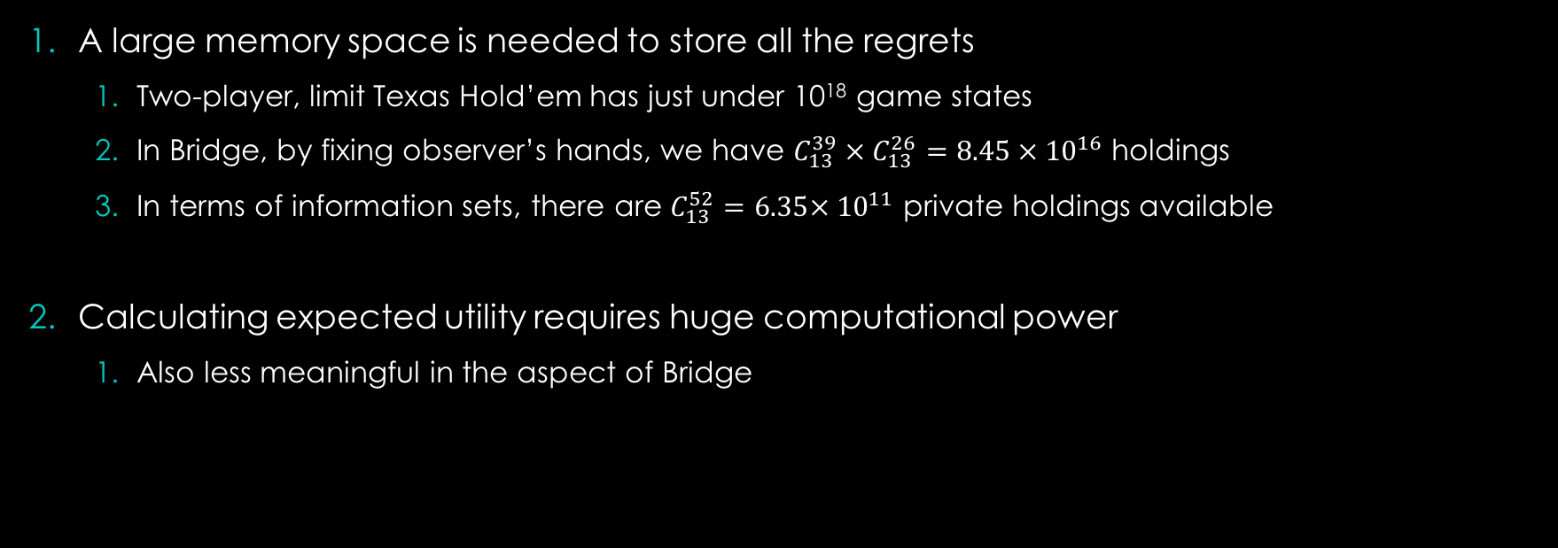
Regret - Difficulty
A large memory space is needed to store all the regrets
Two-player, limit Texas Hold’em has just under 10¹⁸ game states
In Bridge, by fixing observer’s hands, we have $C_{13}^{39} × C_{13}^{26}=8.45 × {10}^{16}$ holdings
In terms of information sets, there are $C_{13}^{52}=6.35× {10}^{11}$ private holdings available
Calculating expected utility requires huge computational power
Also less meaningful in the aspect of Bridge

Slide 25
Regret - Adaptation
We observe that the core of regret minimization is minimizing regret by identifying the right moves
We opt to minimize regret by reducing the probability of incorrect moves
By training a neural network that predicts normalized regret
Reduce the predicted regret value of a wrong move

Slide 26
Design Choices 1 - Bidding
Before our network is sufficiently trained, bidding is regarded as move, not attempts in conveying information
Hence, statistics of partner’s hands are transparent
Statistics are still used instead of raw hands to better adapt into later stages

Slide 27
Design Choices 2 - Player
To reduce noise in training, only two players play and learn from results
The opponents simply pass at all bids

Slide 28
Design Choices 3 - Deals
To further reduce variations between deals, vulnerability is always set to “Game All”
A game-level or slam-level contract made is more rewarding
Any contract downed is more punishable
This reduces the chance of overbidding

Slide 29
Design Choices 4 – Learning Network
Since in the definition of CFR, the policies of opponents are assumed constant
We also dedicate each episode of training to one network

Slide 30
Algorithm 1 - Adaptation of Regret Minimization
1 | Initialize networks with random parameters θ
2 | for each episode do
3 |  | Generate random deal
4 |  | Initialize empty bidding sequence
5 |  | while bidding not ended
6 |  |  | Provide playing network with statistics of other players’ hands, bidding sequence and cards
7 |  |  | Receive a vector of normalized regret value
8 |  |  | Calculate probabilities among legal moves
9 |  |  | Choose a bid according to probability
10 |  |  | Append the bid to bidding sequence
11 |  |  | Check if bidding ended
12 |  |  | Repeat with next player
 |  | end while
13 |  | Decrease regret value of ensured wrong moves of learning network
14 |  | Repeat with next learning network
 | end for

Slide 31
Explanation – Line 13
Bridge is a cooperative imperfect information game
Cannot clearly define a bad move
For example, bidding sequence is “3C-5N-P” and the result is -500, best contract is 4S
How do we know which move should be discouraged?

Slide 32
Explanation – Line 13
For example, bidding sequence is “3C-5N-P” and the result is -500, best contract is 4S
How do we know which move should be discouraged?
We check against 2 conditions
The bid is higher than best contract
The result of such bid doubled is less than par value
The above 2 conditions are sufficient for a state to certainly have negative utility, given logical opponents

Slide 33
Result - Quantitative
 | RM | Random Walk
Players | 2 | 2
Deals Tested | 1,000 | 1,000
Max Gain | 1,420 | 1,420
Max Loss | -2,920 | -2,820
Total G/L | -638,846 | -626,400
Squared Total Error | 701,394,744 | 655,661,400
Total IMP | -9,740 | -9,753
Lvl 7 Boards | 805 | 858

Slide 34
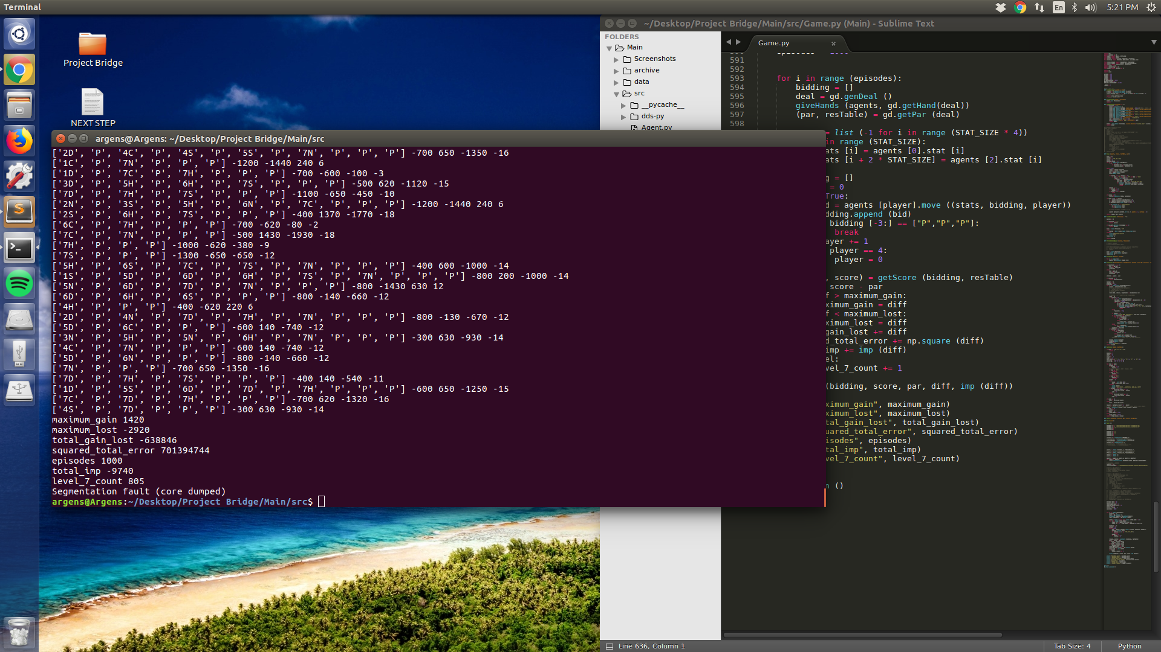
Result - Qualitative

Slide 35
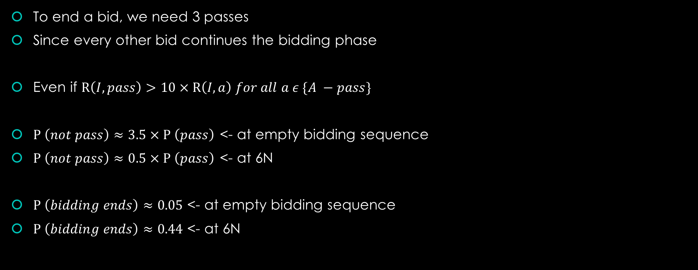
Overbidding
To end a bid, we need 3 passes
Since every other bid continues the bidding phase
Even if $R\left(I, pass\right)>10 × R\left(I, a\right) for all a ε \{A −pass\}$
$P \left(not pass\right)≈3.5 × P \left(pass\right)$ <- at empty bidding sequence
$P \left(not pass\right)≈0.5 × P \left(pass\right)$ <- at 6N
$P \left(bidding ends\right)≈0.05$ <- at empty bidding sequence
$P \left(bidding ends\right)≈0.44$ <- at 6N

Slide 36
Result - Qualitative
Positive results come from opponents not bidding
Eg 1. 5N-6D-7D-7N
-800 score from 7N down 8
Eg 2. 4H
-400 score from 4H down 4
Passing out would have double the gains in result

Slide 37
Result - Qualitative
We know that the result comes form 4 of a Major just made (+620)
7C-7D-7H-P
Yet both bids were way above in level and different in suit

Slide 38
Reflection
The results show that the algorithm is flawed in a few ways
It is inefficient
Only the action value of 1 move in 1 information state is evaluated per simulation
It is not cooperative / myopic
It does not look forward but simply provides response for each information state
It does not take partner’s action into account

Slide 39
Monte Carlo Reinforcement Learning (MCRL)
A combination of Monte Carlo Tree Search (MCTS) and reinforcement learning neural network used in AlphaGo Zero and Alpha Zero
AlphaGo Zero
A RL program which reaches superhuman level in Go without human knowledge
Alpha Zero
A similar program as AlphaGo Zero but reaches superhuman level in multiple games

Slide 40
Monte Carlo Tree Search
A tree search that does searches a game tree pseudo-randomly
Collects statistics by travelling all the way to terminal nodes
Focuses on the more promising subtrees
Efficiency depends on finding promising subtrees

Slide 41
Use of RL neural network
Help predict promising moves that leads to promising subtrees
Helps early termination of search by predicting the game value
Reference: Silver, D., Schrittwieser, J., Simonyan, K., Antonoglou, I., Huang, A., Guez, A., Hubert, T., Baker, L., Lai, M., Bolton, A., Chen, Y., Lillicrap, T., Hui, F., Sifre, L., van den Driessche, G., Graepel, T. and Hassabis, D. (2017). Mastering the game of Go without human knowledge. Nature, 550(7676), pp.354-359.

Slide 42
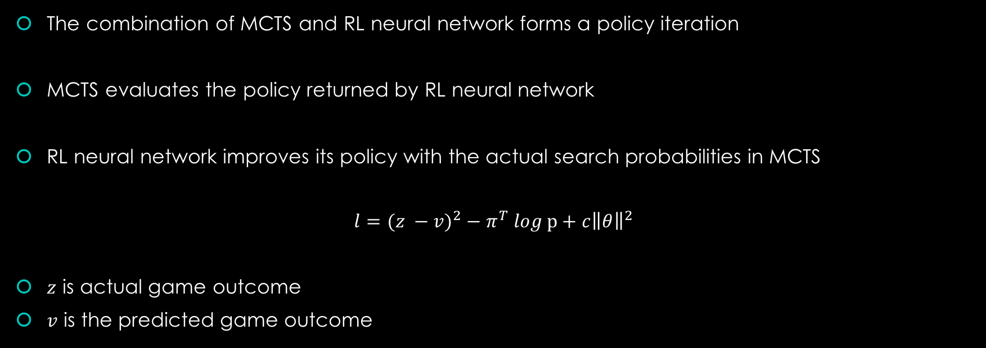
Policy Iteration
The combination of MCTS and RL neural network forms a policy iteration
MCTS evaluates the policy returned by RL neural network
RL neural network improves its policy with the actual search probabilities in MCTS
$$l={(z −v)}^{2} − π^{T} log \text{p}+c{\left\|θ\right\|}^{2}$$
$z$ is actual game outcome
$v$ is the predicted game outcome
Reference: Silver, D., Schrittwieser, J., Simonyan, K., Antonoglou, I., Huang, A., Guez, A., Hubert, T., Baker, L., Lai, M., Bolton, A., Chen, Y., Lillicrap, T., Hui, F., Sifre, L., van den Driessche, G., Graepel, T. and Hassabis, D. (2017). Mastering the game of Go without human knowledge. Nature, 550(7676), pp.354-359.

Slide 43
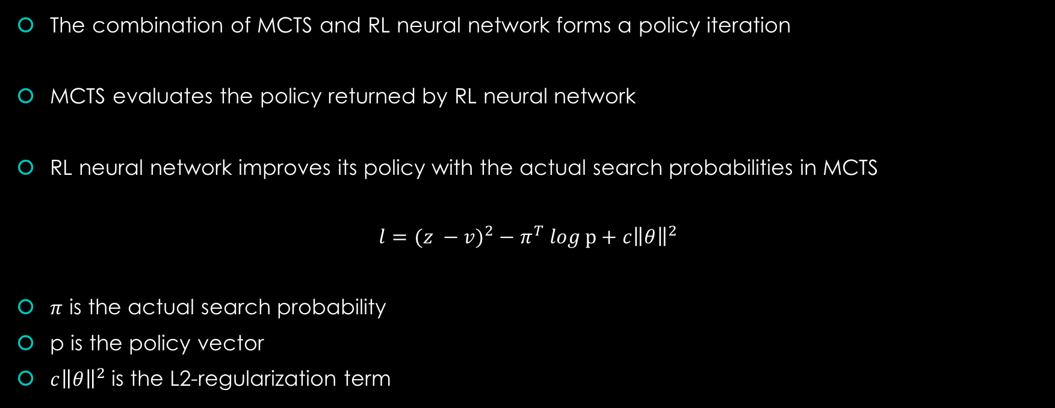
Policy Iteration
The combination of MCTS and RL neural network forms a policy iteration
MCTS evaluates the policy returned by RL neural network
RL neural network improves its policy with the actual search probabilities in MCTS
$$l={(z −v)}^{2} − π^{T} log \text{p}+c{\left\|θ\right\|}^{2}$$
$π$ is the actual search probability
p is the policy vector
$c{\left\|θ\right\|}^{2}$ is the L2-regularization term
Reference: Silver, D., Schrittwieser, J., Simonyan, K., Antonoglou, I., Huang, A., Guez, A., Hubert, T., Baker, L., Lai, M., Bolton, A., Chen, Y., Lillicrap, T., Hui, F., Sifre, L., van den Driessche, G., Graepel, T. and Hassabis, D. (2017). Mastering the game of Go without human knowledge. Nature, 550(7676), pp.354-359.

Slide 44
MCRL- Adaptation
Our adaptation of the MCRL is almost identical except
Each player is privately provided card information before making each move
Each player bids deterministically instead of bidding by a probability proportional to MCTS visit count (like in the first 30 moves of AlphaZero)
Relatively shallow search depth in Bridge and large state space

Slide 45
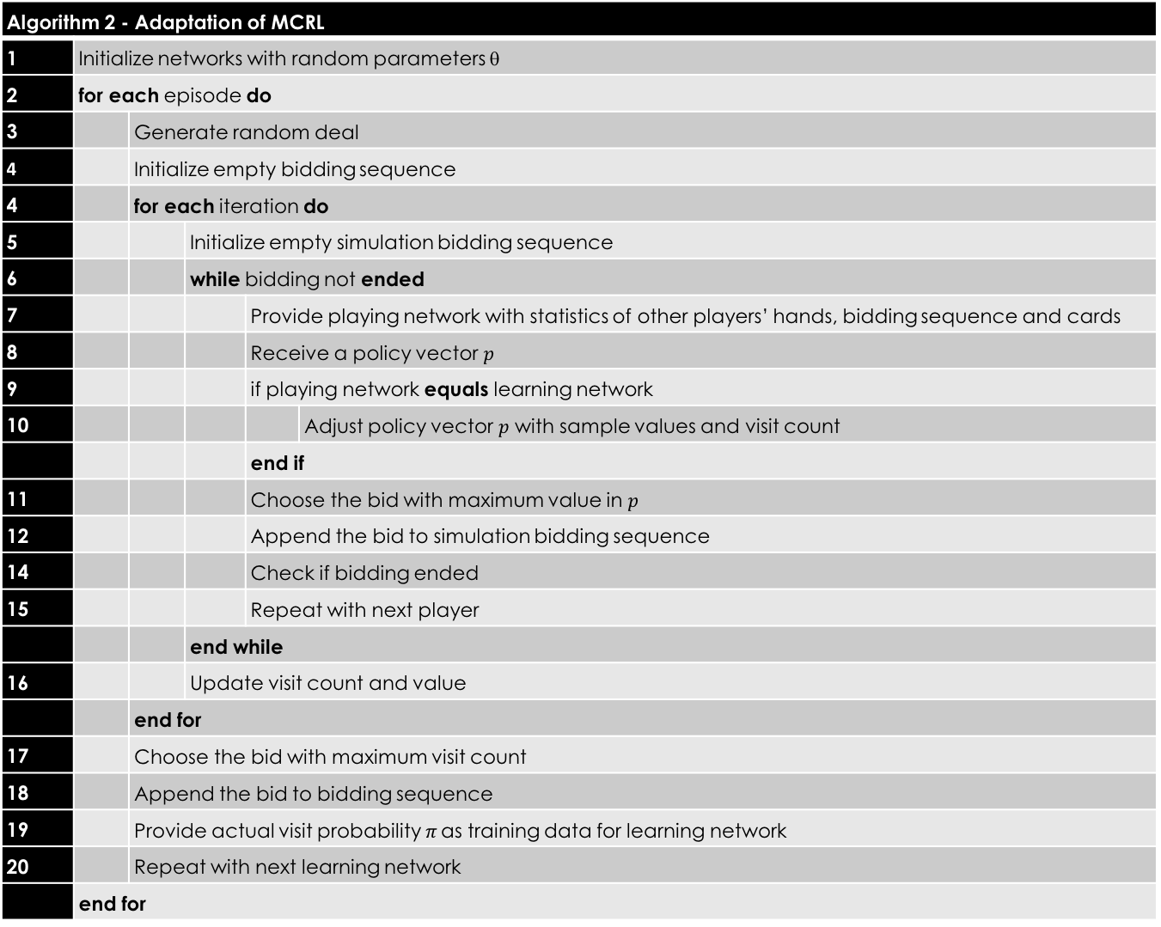
Algorithm 2 - Adaptation of MCRL
1 | Initialize networks with random parameters θ
2 | for each episode do
3 |  | Generate random deal
4 |  | Initialize empty bidding sequence
4 |  | for each iteration do
5 |  |  | Initialize empty simulation bidding sequence
6 |  |  | while bidding not ended
7 |  |  |  | Provide playing network with statistics of other players’ hands, bidding sequence and cards
8 |  |  |  | Receive a policy vector $p$
9 |  |  |  | if playing network equals learning network
10 |  |  |  |  | Adjust policy vector $p$ with sample values and visit count
 |  |  |  | end if
11 |  |  |  | Choose the bid with maximum value in $p$
12 |  |  |  | Append the bid to simulation bidding sequence
14 |  |  |  | Check if bidding ended
15 |  |  |  | Repeat with next player
 |  |  | end while
16 |  |  | Update visit count and value
 |  | end for
17 |  | Choose the bid with maximum visit count
18 |  | Append the bid to bidding sequence
19 |  | Provide actual visit probability$π$ as training data for learning network
20 |  | Repeat with next learning network
 | end for

Slide 46
Exploration
Dirichlet noise is added to reduce the effect of prior probabilities
Prior probabilities are scaled down by reverse of visit count

Slide 47
Result - Quantitative
 | MCRL | Random Walk
Players | 2 | 2
Deals Tested | 1,000 | 1,000
Max Gain | 2,220 | 1,420
Max Loss | -2,220 | -2,820
Total G/L | 18,490 | -626,400
Squared Total Error | 557,534,500 | 655,661,400
Total IMP | 324 | -9,753
Lvl 7 Boards | 0 | 858

Slide 48
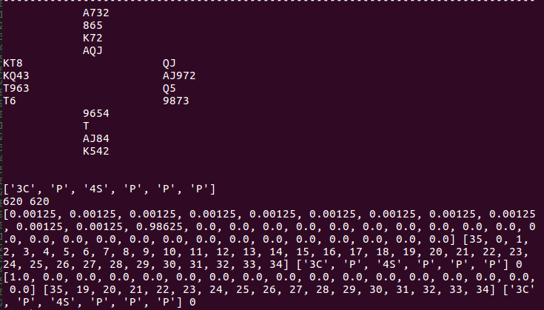
Result - Qualitative

Slide 49
Result - Qualitative

Slide 50
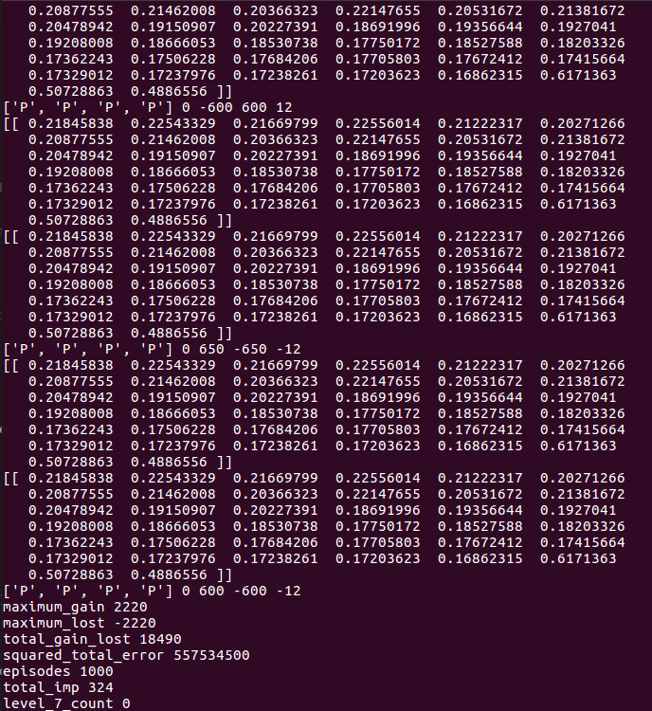

Slide 52
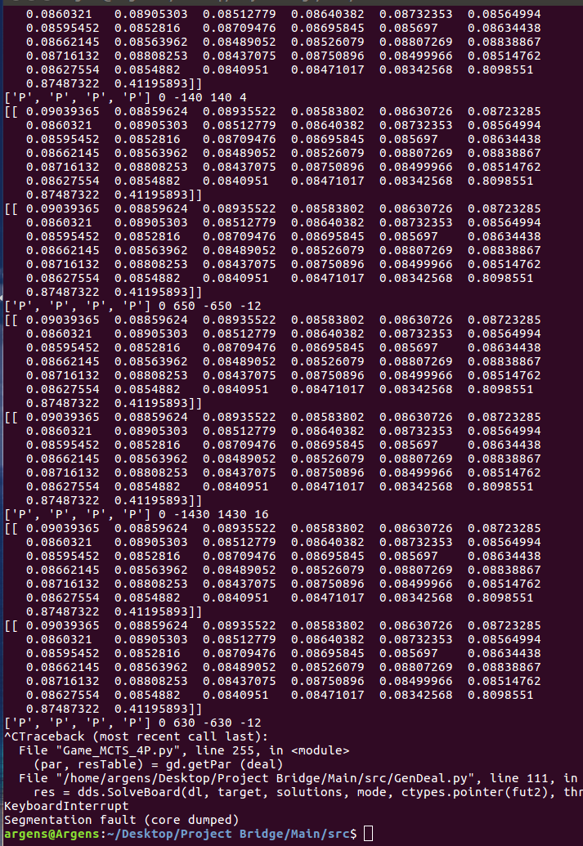

Slide 53
Reflection
The excellent results in training simply comes from look forward simulations in MCTS
And Pass is the only commonality captured by our network

Slide 54
Reason For Failure
Large state space for Bridge
Low correlation between actions and states
Low correlation between states and results

Slide 55
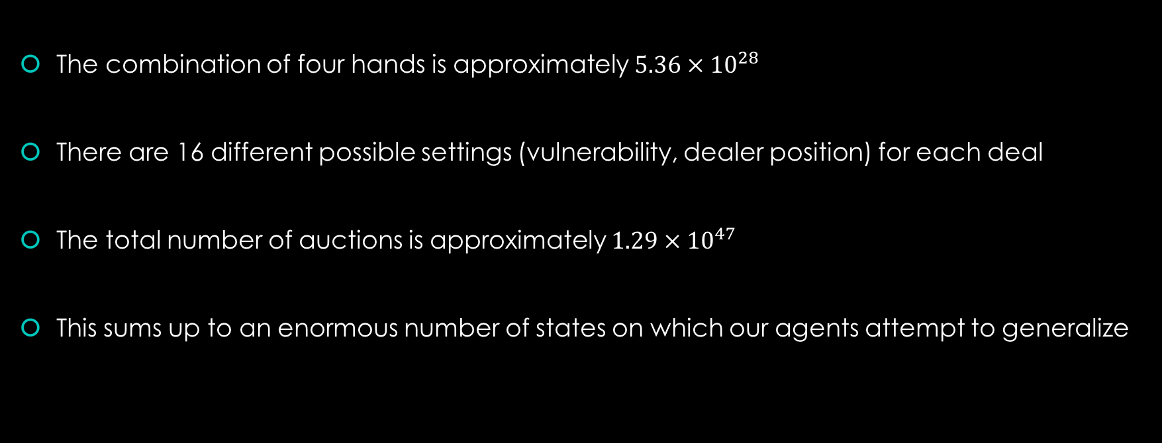
Large State Space
The combination of four hands is approximately $5.36 × {10}^{28}$
There are 16 different possible settings (vulnerability, dealer position) for each deal
The total number of auctions is approximately $1.29 × {10}^{47}$
This sums up to an enormous number of states on which our agents attempt to generalize

Slide 56
Low correlation between action and states
Assume the best contract in a hand is 5-Spades
The agents could have various different ways of bidding before reaching 5-Spades and passing
And we can only evaluate them as equally good biddings
This is again, unlike other games a determining move can cause certain states unreachable
This deters both tree search and regret minimization

Slide 57
Low correlation between states and results
In a game of Poker and we hold two Aces
The flop has both broken suits and spots yet the pool is large
We are in a good spot
In a game of Go
The state of the game can be evaluated approximately with territories and stones

Slide 58
Low correlation between states and results
But in Bridge, assume we hold
Spades: AQxx
Hearts: KJx
Diamonds: Jxx
Clubs: AJx
And we bid 1NT, what position are we in? This question is usually meaningless unlike in other games, due to the cooperative nature of the game.
This limits the effectiveness of forward searches

Slide 59
Low correlation between states and results
An experiment actually shows the low correlation.
By training a convolutional neural network through supervised learning to predict the number of tricks North can get on a NT contract

Slide 60
Low correlation between states and results
 | First Approach | NT_by_N
Players | 2 | 1*
Deals Tested | 1,000 | 1,000
Max Gain | 1,420 | 1610
Max Loss | -2,920 | -1,960
Total G/L | -638,846 | -176,330
Squared Total Error | 701,394,744 | 449,294,610
Total IMP | -9,740 | -3,036
Lvl 7 Boards | 805 | 0

Slide 61
Low correlation between states and results
We still get a less than satisfactory network, even when the mean squared error in testing data was already at 3.79.
Passing already gets us positive G/L

Slide 62
Reflection
The approach should be focusing on creating a language
Bids should be regarded as tokens not moves
There can be a set of human abstracted information as goal

Slide 63
Thank You

